Slide 1
Notes:
ASEA Cellular Health is a fast-growing global company based on a new field of science called “Redox Signaling”.
We believe that the pathway to health lies in the body’s profound ability to heal itself.
Our company’s scientific breakthrough is positioned to affect almost all areas of health and personal well-being.

Slide 2
Products
Patents
Purpose
Opportunity
Notes:
People are excited about our company because it is pioneering and unique! ASEA Cellular Health is the only company in the world that has developed Redox Signaling Technology.
ASEA Associates are inspired and purpose-driven. Our products are not only different from anything else available but they deliver powerful results that truly change people’s lives!

Slide 3
ASEA Mission:
To better people’s lives and to be a force for good in the world.
35 Countries & Expanding:
North America, Europe, Australia/New Zealand, Asia
Cumulative Sales Volume:
$650 million
Launched 2010
Profitable year 1
Debt Free / Privately held
Notes:
ASEA’s Mission is “to better people’s lives and to be a force for good in the world”.
ASEA launched in 2010 with just one revolutionary product. Without any advertising whatsoever, the company has expanded into 35 countries, proving the tremendous power of word-of-mouth marketing! When a product works, people want to tell others about it!

Slide 4
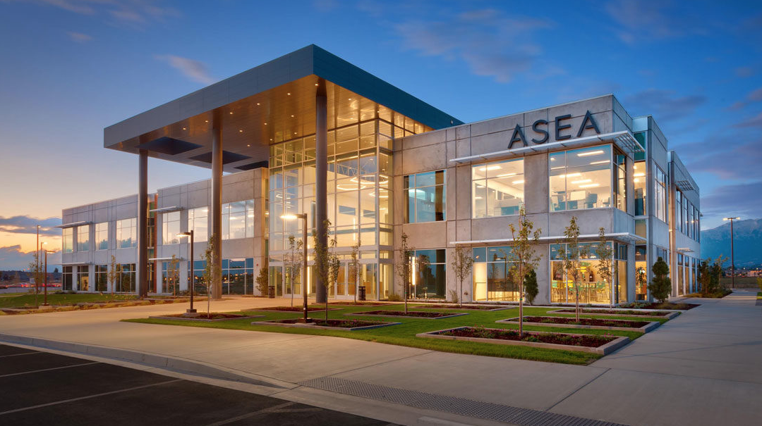
Revenue Curve Shows
Increasing Demand
for ASEA
Notes:
How is it possible for just one product to spearhead this type of growth - year after year - by word-of-mouth only?

Slide 5
10-15 Years Ahead of Its Time
Cutting Edge Technology
New Category of Science
Notes:
Because growth was fueled by a heavily patented, cutting edge technology 10-15 years ahead of its time.
A groundbreaking health and anti-aging breakthrough providing consumers with incredibly powerful results!
ASEA Redox Cell Signaling Supplement has been called by many people the single greatest health science breakthrough of our lifetime!

Slide 6
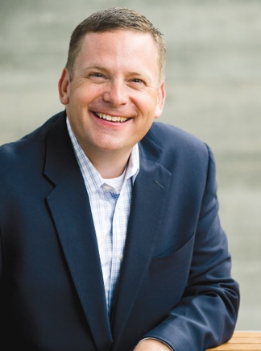
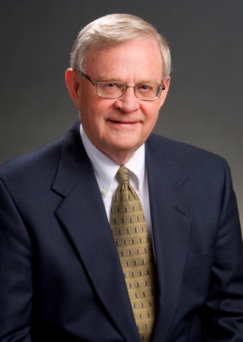
ASEA Founders turned down offer from Pharmaceutical Company
Verdis Norton
Tyler Norton
Notes:
The company was founded by a father and son team, Verdis Norton and his son Tyler Norton. Verdis had been considered a "Who's Who?" executive in a Fortune 10 company and was nearing retirement, and Tyler had developed a very successful career as a brilliant executive in his own right.
Prior to the company launch, the Nortons had turned down an offer from a pharmaceutical company, an offer that would have guaranteed generational wealth. The Big Pharma company had reviewed 17 years of clinical studies, data, and research on the redox signaling technology the Nortons had acquired.
But the Nortons believed this life-changing health breakthrough should be brought directly to the people, by the people, and ASEA was born.

Slide 7
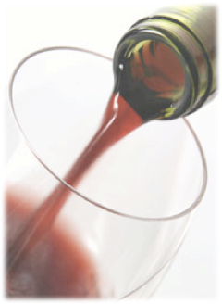
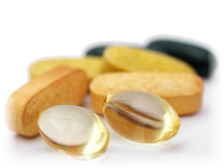
Redox Molecules
are NOT...
Vitamins
Minerals
Antioxidants
Exotic Juices
Alkaline Water
Redox Molecules enhance vital cellular functions, improve total body health, and empower every system of the body to function optimally.
Notes:
To better understand what ASEA is, it’s helpful to know what it’s NOT.
It contains no vitamins, minerals or anti-oxidants. It’s not like another type of exotic juice or plant - or another type of alkaline water.
ASEA contains MOLECULES that are native to the human body. Molecules that enhance vital cellular functions, improve total body health, and help every system of the body to function better.

Slide 8
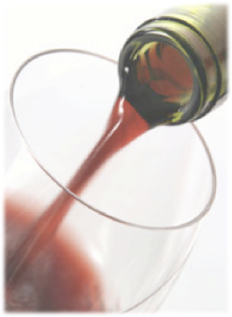
Unlike Any Other Product!
ASEA Is Not:
Vitamin
Mineral
Antioxidant
Exotic Juice
Structured / Alkaline Water
Notes:
To understand Redox Signaling Molecules, it’s helpful to know what they are NOT.
They are not vitamins, minerals or anti-oxidants. They are not another type of exotic juice. They are not another type of alkaline or structured water.

Slide 9
Redox Signaling Molecules
Different
True Category Creator
New Frontier of Science
Sustainable
Heavily Patented
No Competition
No Copy Cats
Advantage
Meaningful Results
Premier Business Opportunity
Notes:
ASEA IS a true category creator developing unique products based on an entirely new frontier of science.
ASEA’s position in the marketplace is sustainable due to many patents - along with corresponding proprietary knowledge.
We have zero competition and no copycats because we created and “own” this category!
And ASEA’s products deliver very meaningful results that are transforming lives. All this offering a premiere business opportunity for everyday people who share our vision.

Slide 10
What are Redox Signaling Molecules?
Energy
The Cell (salt water)
REDOX
Reductants: cellular activators that help prevent cell damage and disease.
Oxidants: cellular messengers that help balance the immune system to protect against harmful bacteria, viruses, and infection.
Redox Signaling Molecules
}
Notes:
What are Redox Signaling Molecules?
Up to 60-70% of our body is water, saline (salty water).
Every one of your trillions of cells are constantly producing energy- the essence of life!
In the process of producing energy, your own cells create “Redox Signaling Molecules”. Once thought to be nothing more than a byproduct of energy production… scientists now know these molecules are critical to life.
Redox comes from 2 words:
Reductants: cellular activators that help prevent cell damage and disease.
Oxidants: cellular messengers that help balance the immune system, protect against harmful bacteria, viruses, and infection.

Slide 11
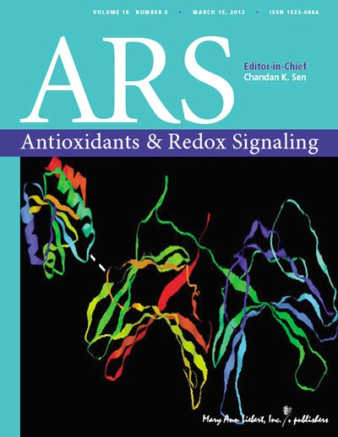
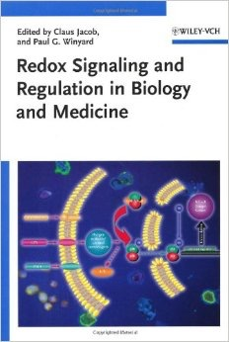
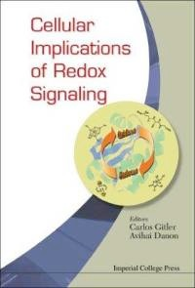
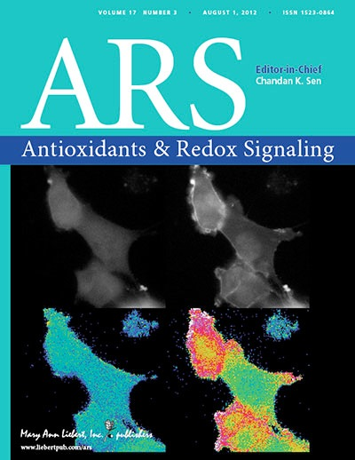
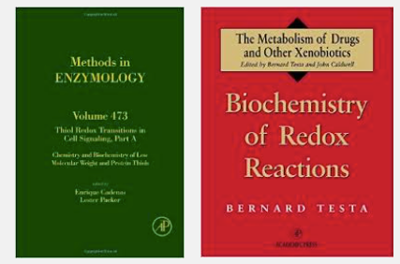
Redox Biochemistry:
one of the fastest growing areas of science in the world!
Over 1,200 books on Redox BioChemistry have been published
Over 10,000 studies on Redox Signaling have been published in peer-reviewed scientific and medical journals!
Notes:
ASEA’s technology is based on “Redox Biochemistry”.
Over 10,000 studies on “Redox Signaling” have been published in scientific and medical journals.
Although you may not have heard of it, over twelve hundred books have been published on the subject.

Slide 12
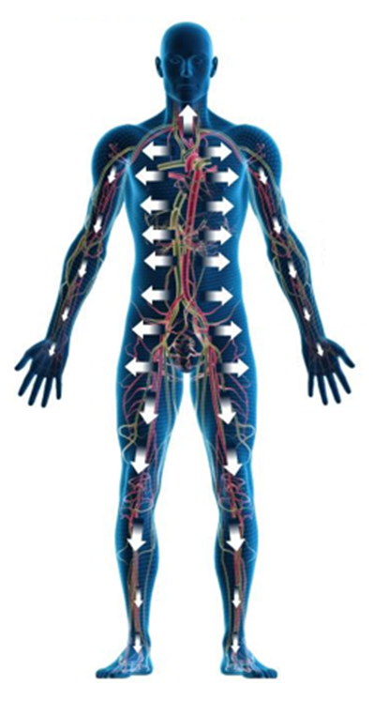
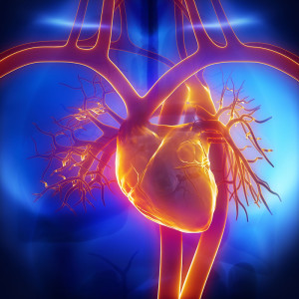
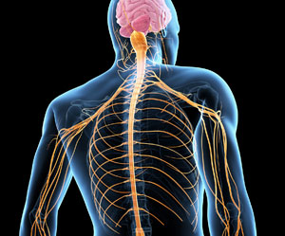
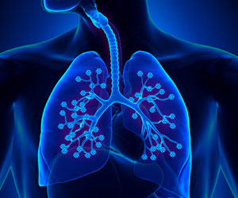
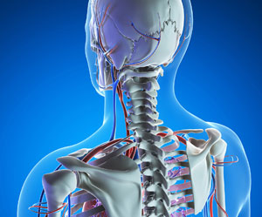
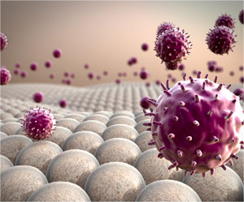
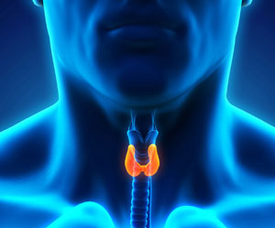
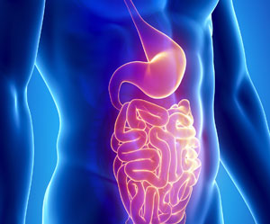
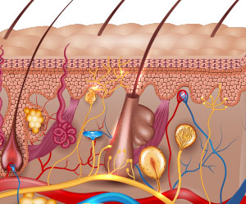
Redox Signaling Molecules
Play a critical role in the healthy regulation of all major body systems
Notes:
Redox Signaling Molecules play a critical role in the healthy regulation of all major body systems.

Slide 13
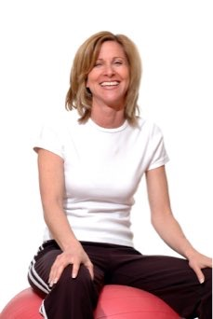
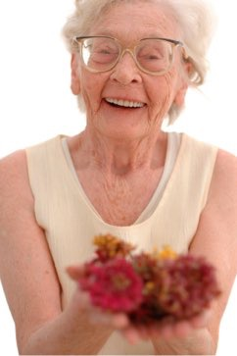
With Age, Poor Diet, Stress Our cells produce less Energy
Deficiencies and Imbalances in Redox Function
Notes:
Most of us had plentiful and balanced Redox Molecules when we were very young. But as we age, our body produces fewer and fewer redox signaling molecules due to the effects of cellular damage. Damage occurs because of environmental toxins, poor diet, stress, unhealthy habits, sun damage, and the influences of normal aging
We can become burdened by physical problems. Joints can hurt. We don’t sleep as well. Mood and a sense of well-being suﬀer and fatigue sets in. Our immune system gets weaker or becomes confused.
Skin ages more rapidly, and we no longer heal as quickly from injuries.

Slide 14
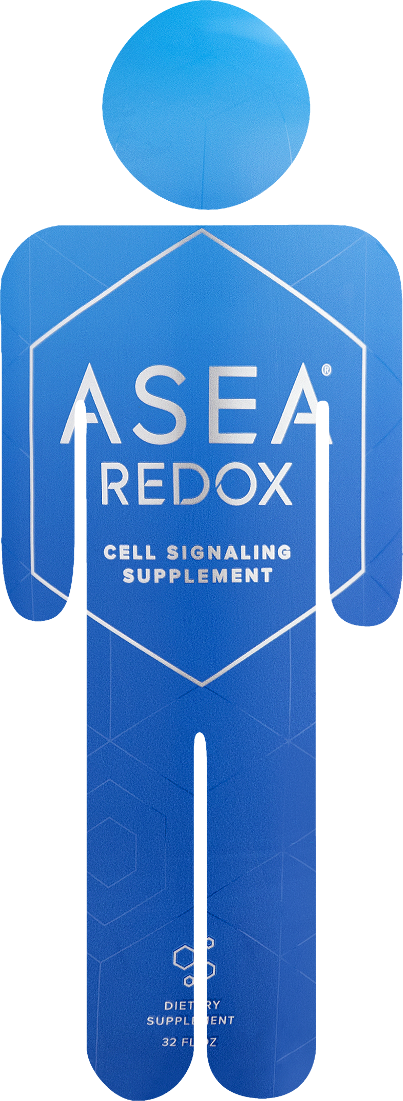
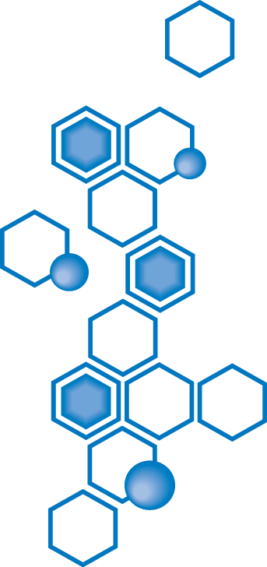
Notes:
Many people assume these issues are inevitable or just a part of aging. But researchers now understand that many are the result of deficiencies and imbalances in Redox function.
What if there were a way to replenish these molecules... so that we could start to look, feel, and perform the way we did 5-10-15-20 years ago??

Slide 15
ASEA Redox Breakthrough
After extensive research, laboratory testing, and millions of dollars, a team of scientists achieved the impossible.
They stabilized Redox Signaling Molecules outside of the body in perfect balance as they are found in healthy cells.
Notes:
After years of research, testing, and investing millions of dollars, a team of scientists achieved what seemed impossible.
They created Redox Signaling Molecules outside of the body. And they stabilized them so that they can be stored and consumed as a supplement, the same perfect balance found in healthy cells.

Slide 16
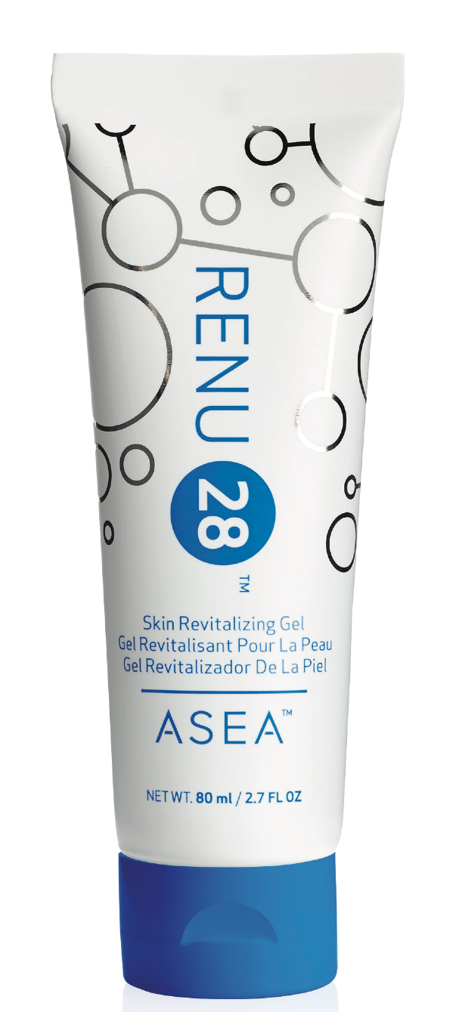
One Company has harnessed
the
Power
of
Redox
Molecules
Notes:
ONLY ONE company in the entire world has harnessed the power of Redox Signaling Molecules.

Slide 17
Notes:
That company is ASEA!
This patented technology is a revolutionary health science breakthrough that many consider a GIFT to humanity, at a time when we have a massive amount of cell-damaging toxins in our environment.

Slide 18
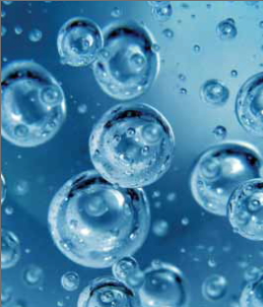
ASEA’s Patented 3 Step Process
Step 1
Pristine saltwater
(same as found inside your cells)
Step 2
Saltwater broken down into free floating atoms
NA-Cl-H-O
Step 3
Atoms restructured into STABILIZED Redox Signaling Molecules
Notes:
ASEA starts with 2 simple ingredients: pure water and salt. Why?
Because when our cells make Redox Molecules, they use water and salt, resources they have in abundance. ASEA’s patented technology replicates the body’s natural process.
The water and salt molecules are broken into free-floating atoms. Then they are restructured into Redox Signaling Molecules, perfectly balanced in a way most supportive to the human body!

Slide 19
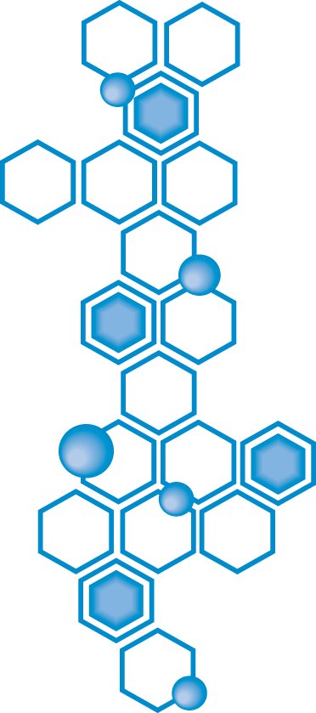
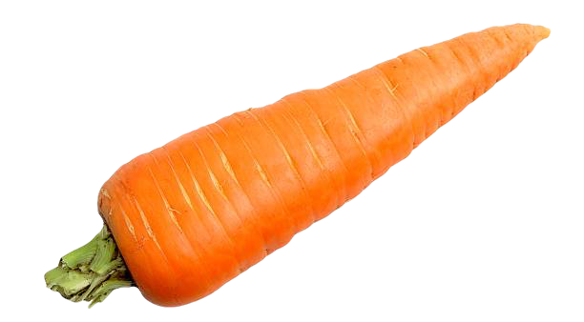
ASEA Redox Signaling Molecules made from
“water & salt”,
just the way our cells make them.
1 serving of ASEA contains less sodium than a carrot
Notes:
Why does the ingredients label on ASEA say water and salt? Because those are the ingredients that are used to make Redox Molecules. Just as flour and water are used to make bread.
It’s important to know that one serving of ASEA contains less sodium than a carrot

Slide 20
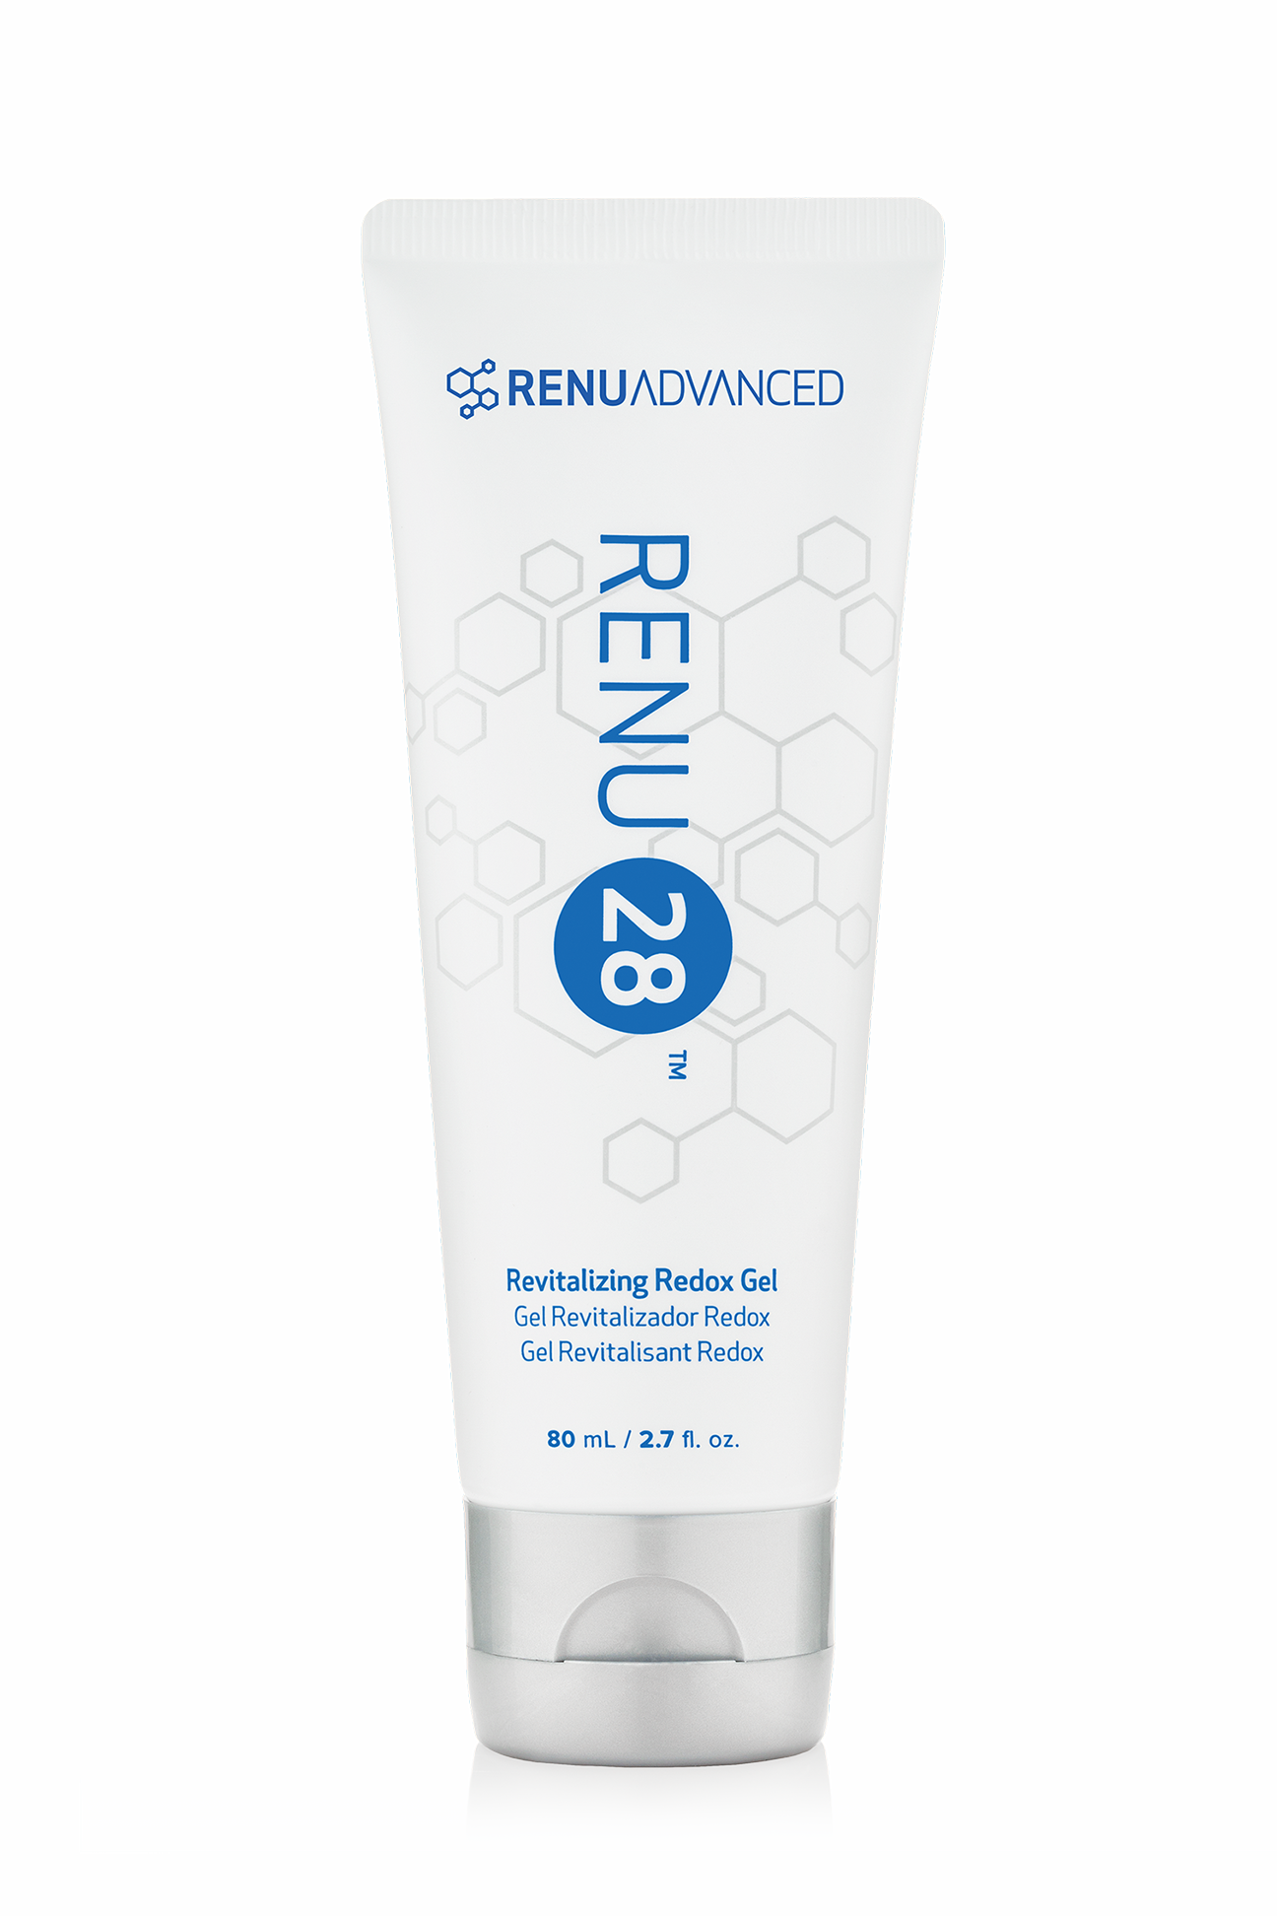
The ASEA Breakthrough
17 Years Research, Multiple International Patents Proprietary Processing Secrets
Redox Signaling Molecules:
Empower your cells to restore themselves
Native to the body
No banned substances
100% safe
Low sodium content
Notes:
ASEA helps to empower your 75 trillion cells to rejuvenate themselves - so that your body can function more like it did when you were younger.
ASEA enhances athletic performance and endurance without any “banned substances”. Extensive safety studies have proven ASEA Redox Supplement is 100% safe.

Slide 21
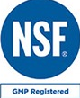
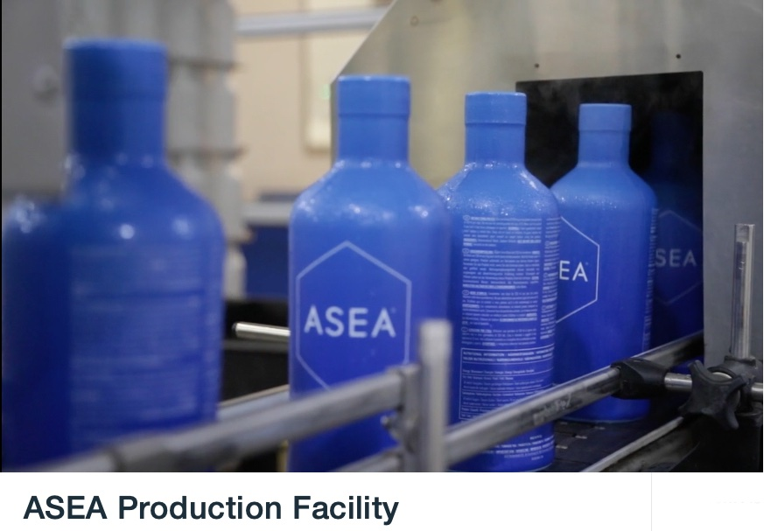
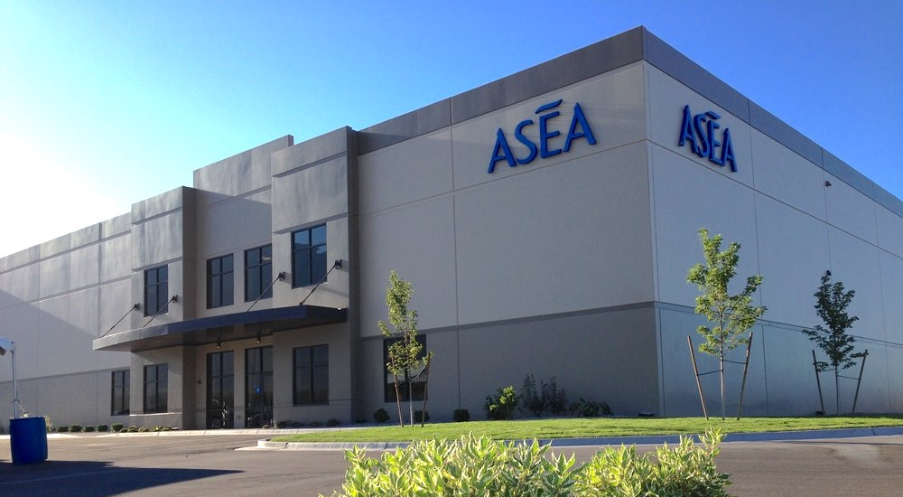
NSF Certified, GMP
FDA Registered, Kosher
ASEA Manufacturing Plant
Pleasant Grove UT USA
Notes:
The one-of-a-kind, in-house manufacturing plant is located in Pleasant Grove, Utah. It’s an FDA Registered and NSF Certified facility. ​
NSF is ​an accredited third-party certification body that tests and certifies products to verify they meet public health and safety standards.

Slide 22
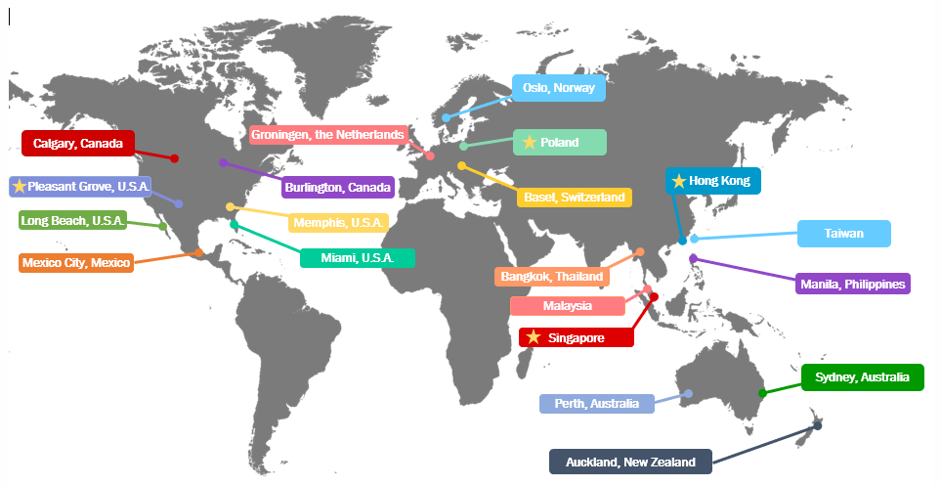
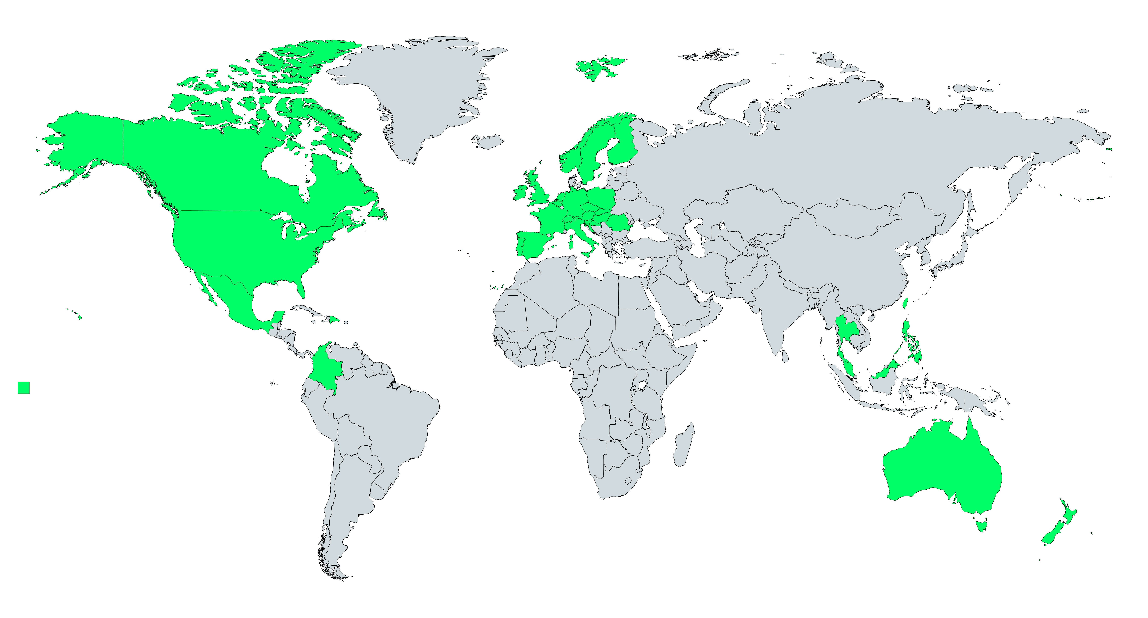
Global Distribution
Global Shipping and Distribution Centers
Notes:
ASEA then ships the product to distribution centers all around the world, serving all countries where ASEA is open.
(July 2018)

Slide 23
Information vs
Mis-information?
Notes:
Positive information on ASEA abounds on the internet. BUT keep in mind that Google is a search engine and not a research engine. Some people “google” ASEA and see a website that claims ASEA is just expensive salt water.
This particular blog article doesn’t acknowledge the many clinical studies on ASEA. The false claim that ASEA is just salt water is made by one non-practicing physician who retired decades ago and is now a paid blogger.
The site also bashes other things that could be considered “natural alternatives to pharmaceuticals” - like chiropractic care, naturopathy, acupuncture, and even vitamins.

Slide 24
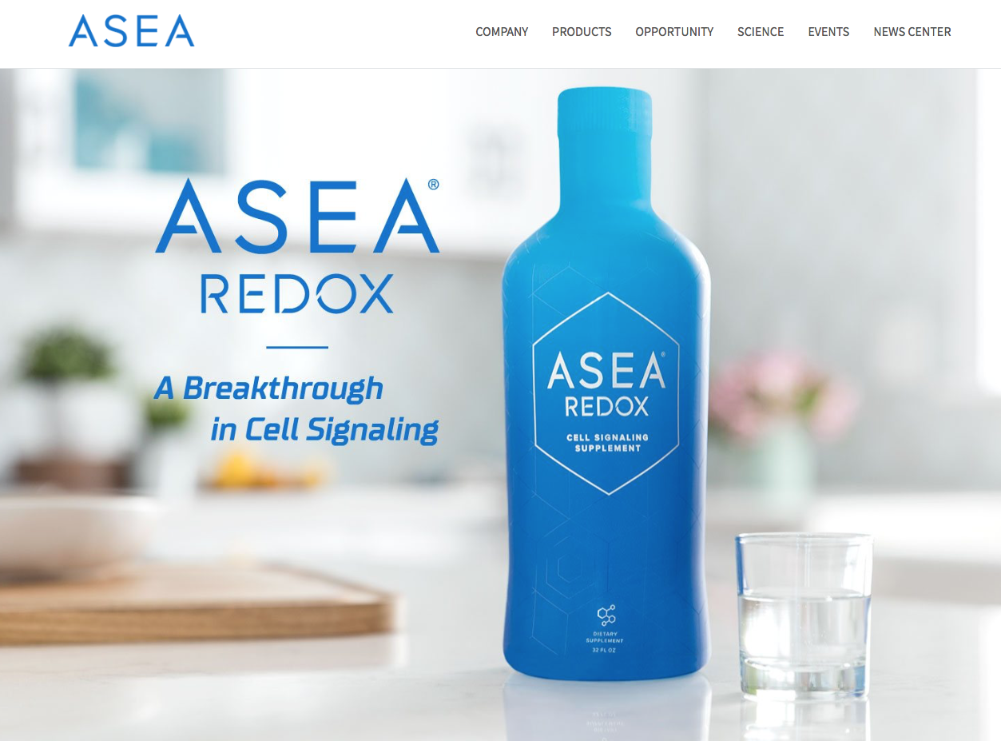
www.AseaGlobal.com
Notes:
You can ﬁnd facts about ASEA’s scientiﬁc validation at aseaglobal.com (and much more)

Slide 25
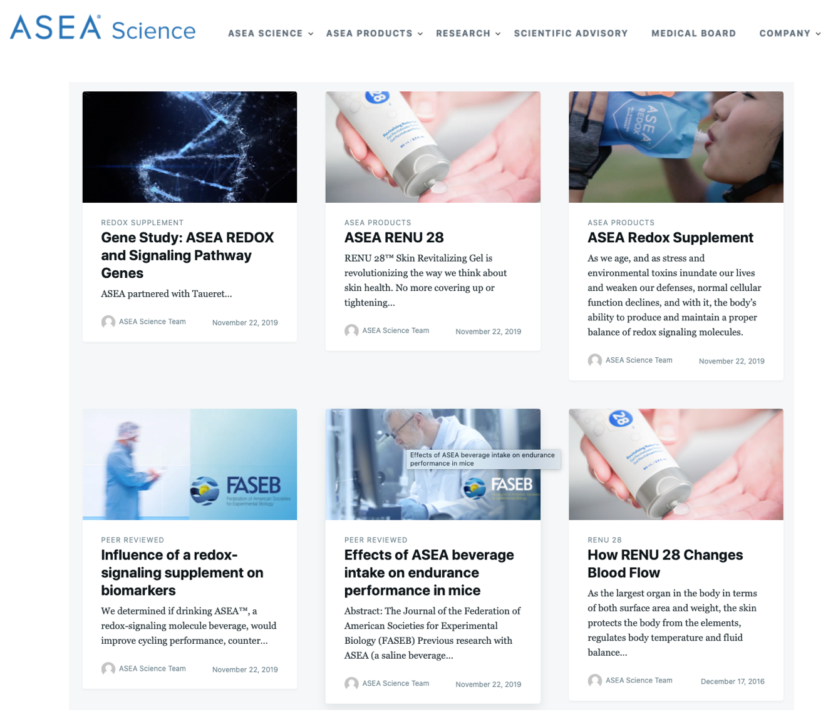
www.AseaScience.com
Notes:
...and also at aseascience.com

Slide 26
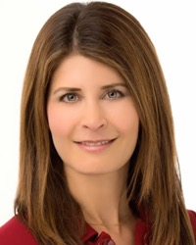
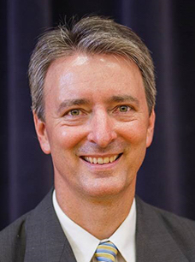
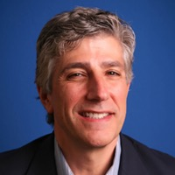
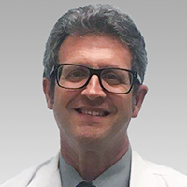
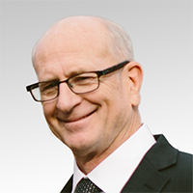
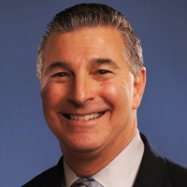
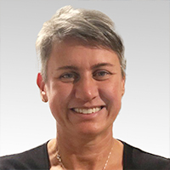
ASEA Science Council
Karen R. Stolman, M.D
Brooke Alpert, M.S., R.D., C.D.N.
Dr. Richard Watt, Ph.D.
ASEA Medical Professionals Board
Dr. David Silverman, D.P.M.
Dr. Richard G. Michal, M.D.
Dr. Maureen Hayes, M.D.
Dr. Houng King, L.A.C., C.M.D.
Jerry White P.T.
Dr. Foster Malmed, D.C., P.C.
SallyDymond, L.R.M.T.
Notes:
Many doctors, scientists, athletes, and well-known experts in various fields have endorsed ASEA - and they are rapidly growing in number.
Many are engaged in distinguished careers and have very impressive credentials. They have reviewed the research. Some volunteer their time on ASEA’s behalf.
ASEA is attracting great minds, big hearts, and spiritually-minded people who believe they have a responsibility to share this gift with humanity.

Slide 27
World Class Institutes for Clinical Trials & Testing
Notes:
ASEA partners with world-class 3rd party independent laboratories for clinical trials and testing.

Slide 28
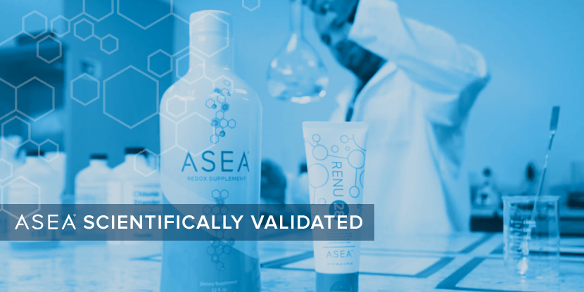
Notes:
BioAgilytix Laboratories performs bio-analysis for many top global pharmaceutical and biotech companies.
BioAgilytix routinely verifies the presence of stabilized, bio-active Redox Signaling Molecules in ASEA’s Redox products.

Slide 29
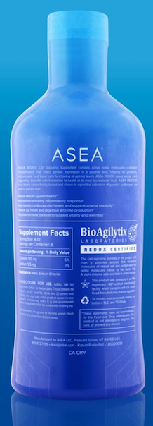
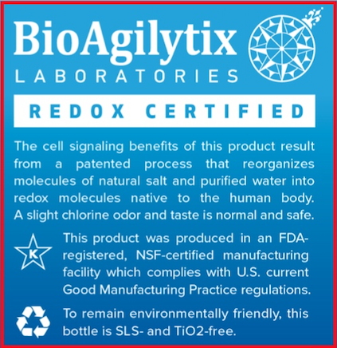
Notes:
Every bottle of ASEA Redox Supplement and every tube of Redox Gel (which is the ASEA supplement in a concentrated gel form) sold in North America is labeled with the BioAgilytix “Redox Certiﬁed” seal. A guarantee that the products contain Redox Signaling Molecules.

Slide 30
ASEA Regulates Healthy Gene Expression
In an 8 week study ASEA REDOX was shown to activate gene signaling pathways
that positively impact
5 major areas of health
Hormone
Modulation
Immune System
Healthy
Digestion
Inflammatory Response
Cardiovascular Health
ASEA REDOX is not a treatment or cure for any disease or medical condition
Notes:
- Taueret Laboratories is one of the most sophisticated ​genetic​ testing labs in North America. They conducted a ground breaking 8 week randomized double-blind placebo controlled study where ASEA REDOX was shown to activate gene signaling pathways that positively impact 5 major areas of health
1. Improve immune system health
2. Help maintain a healthy inflammatory response
3. Help maintain cardiovascular health and support arterial elasticity
4. Improve digestive health
5. Modulate hormonal balance
This helps explain why ASEA users are reporting such a huge variety of system-wide improvements!

Slide 31
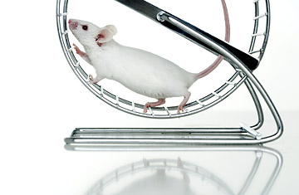
ASEA: Athletic Breakthrough
ASEA is empowering Athletes to experience improvements in…
Endurance
Strength
Recovery
Mental Stamina
Mice drinking ASEA for only 7 days ran 29% further to exhaustion!
* ASEA is made from Salt and Water and therefore does NOT contain any banned substances.
Notes:
ASEA is empowering athletes to perform better! They are reporting improvements in:
➢​ Endurance
➢​ Strength
➢ ​Recovery
➢​ Mental Stamina
Mice drinking ASEA for 7 days ran 29% farther before becoming exhausted!
Imagine what going 29% farther can mean to a competitive runner, an avid cyclist, an Olympic swimmer ... ​or​ a busy parent!
Details on all these studies, and more, available on aseascience.com

Slide 32
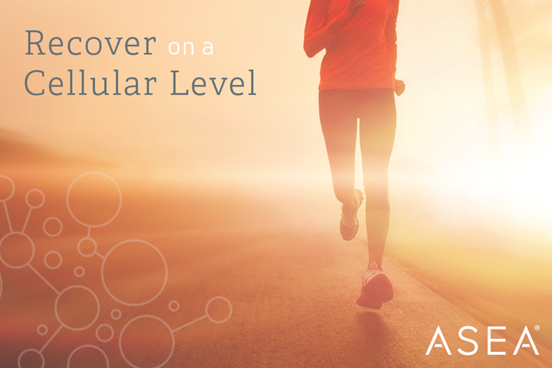
Who Can Benefit from Redox Technology?
Sports & Athletics
Health & Wellness
Beauty & Skin Care
Notes:
ASEA has created something revolutionary that can beneﬁt everyone! Something no other company in the world has, something perfectly safe, with no side effects.
Everyone cares about feeling good, having more vibrant health and less discomfort.
Everyone beneﬁts from faster recovery and more endurance.
And most people enjoy looking younger and having healthy skin!

Slide 33
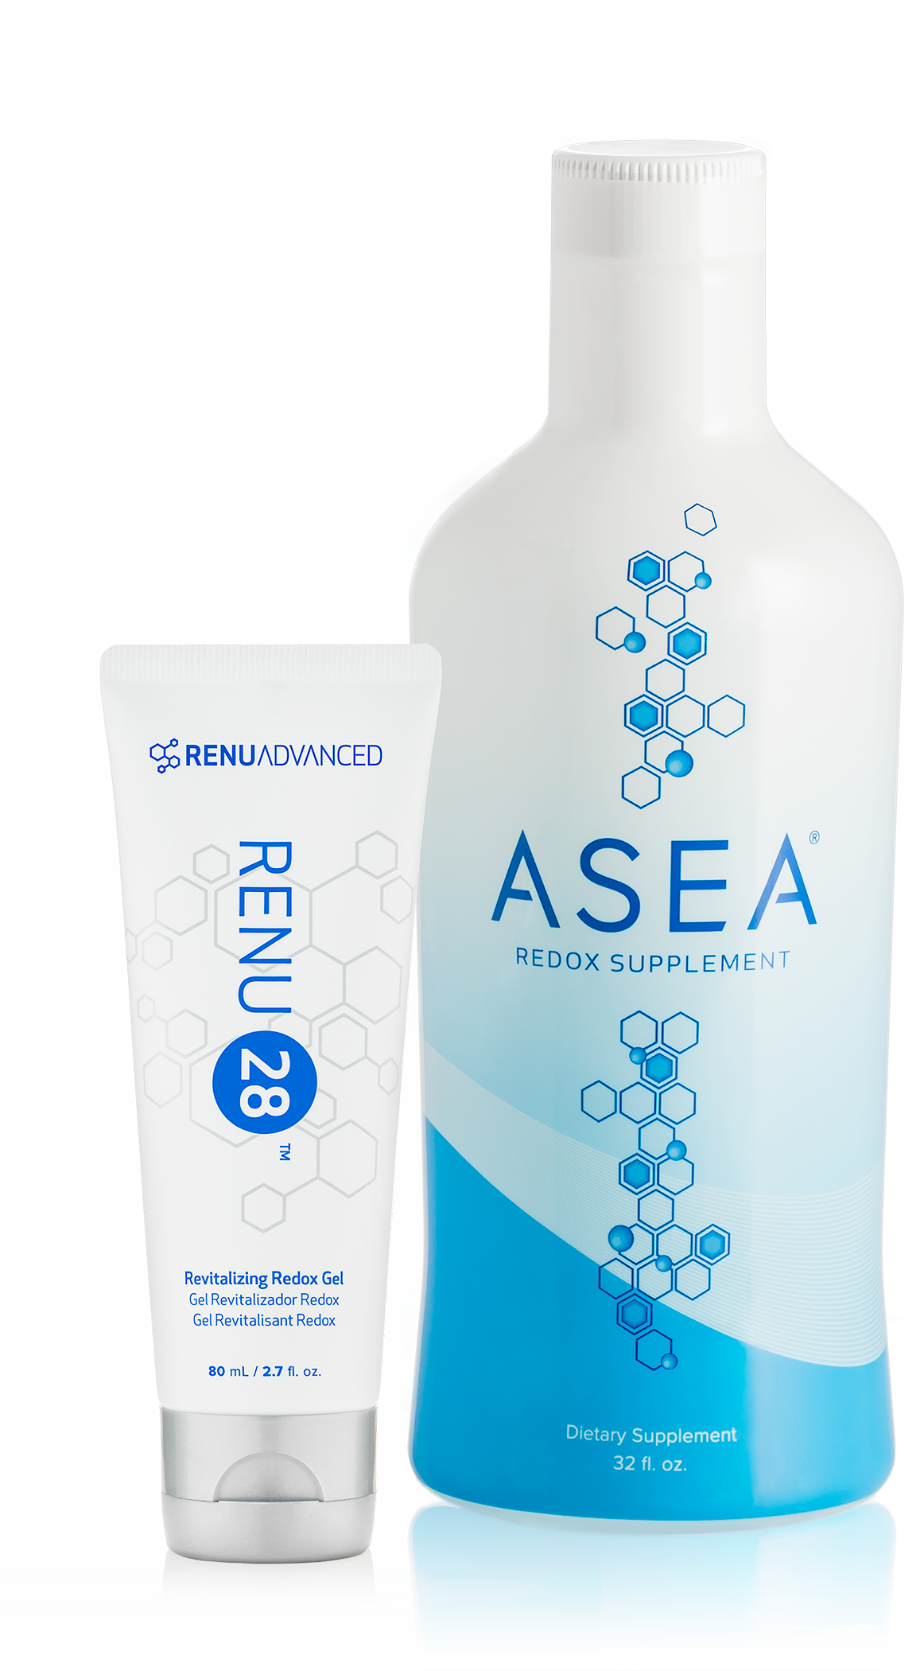
ASEA Product Line
CELLULAR HEALTH
REDOX
Flagship Technology
Notes:
So far we've been focusing on our flagship product, ASEA Redox Cell Signaling Supplement.
Now let's look at RENU 28, which is simply our liquid REDOX supplement made into a more concentrated TOPICAL gel.

Slide 34
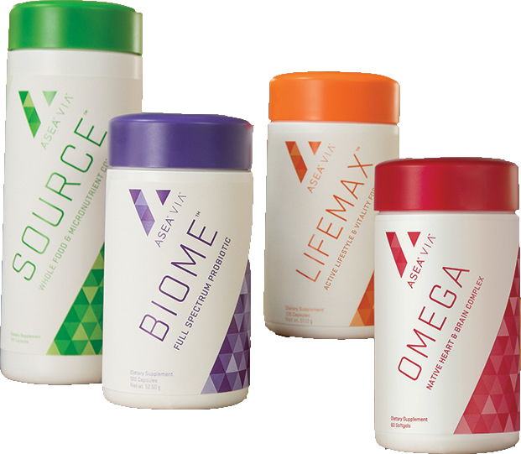
ASEA Product Line
CELLULAR HEALTH
REDOX
Flagship Technology
ASEA VIA NUTRITION
RENU ADVANCED SKINCARE
Complementary
Cellular Health
Technologies
Complementary
Cellular Health
Technologies
Notes:
ASEA began with their core Flagship Redox Products: the Redox Supplement and the Redox Gel
-and has been strategically expanding their product line into the areas of (click) Health & Wellness, and (click) Health & Beauty.
Click: Let’s focus now on the Health & Beauty - Renu Advanced Skincare

Slide 35
ASEA REDOX
Flagship Cellular Health
Technology
Redox Gel
ONLY 4 INGREDIENTS in the Redox Gel
}
Water
Sodium Chloride
Sodium Magnesium Fluorosilicate
Monosodium Phosphate
Redox molecules
Preservative Free
Non-Comedogenic
Hypoallergenic
Paraben Free
Notes:
Incredibly, RENU 28 has only has 4 Ingredients!
- Water & Sodium Chloride (used to make the Redox Signaling Molecules)
- Sodium Magnesium Fluorosilicate, a non-toxic synthetic clay used to make it into a gel - Monosodium Phosphate, a pH buffer to make it perfect for skin
We always shake the tube ​[demonstrate] first and use on clean, dry skin. You can rub Renu 28 onto any area of the body.

Slide 36
ASEA REDOX
The most advanced whole body skin technology ever brought to market.
Simple
Proven
Affordable
Effective
Flagship Cellular Health
Technology
Notes:
Let’s begin by learning about ASEA’s Redox Gel, called RENU 28. RENU28 has helped tens of thousands of people to achieve cellular health from the Outside In:
It’s simple & pure.
It’s proven safe & hypoallergenic.
It’s affordable & very multi-purpose.
It is effective - for improving skin health & also for relief of aches & discomfort.

Slide 37
Independent Clinical Studies
ASEA REDOX
Flagship Cellular Health
Technology
Cell Renewal
Smoothness
Wrinkles
Elasticity
Cellulite
Blood Flow
16%
Age Slower
Skin Challenges
First Aid
Discomfort Relief
General Health
23%
23%
20%
16%
50%
Notes:
And you don’t have to take our word for it. RENU 28,was subject to several independent clinical studies in North America and Europe. And the results were astonishing. ...showing a 16% improvement in this vital skin cell renewal rate in only 4 weeks. And when your skins cells start to renew like they did when you were younger... you can begin to look like you did when you were younger. A 20% or more improvement in smoothness, tone and elasticity as a result of working with the body’s natural renewal processes! Blood flow to the area showed a massive 50% increase in just 4 days!
This not only improves overall skin health, but also impacts what is beneath the skin!.
So, at this point let’s take a look at the kind of results people are seeing using RENU 28.

Slide 38
Age Slower
28 Days applying Redox Gel
NO
Redox Gel
Notes:
Do you see a difference between the two sides of this man’s face? Dr Marty Morin was a huge skeptic and he wanted to see what would happen if he put RENU 28 on half of his face for 28 days, but none on the other half! You can see the results for yourself!

Slide 39
Feeling is Believing
Experience Redox Molecules
“3 in 5”
Identify an area of the body where there is discomfort, soreness, stress, tightness, or limited range of motion
Rate it on a scale of 1-10 (10 is bad)
Apply Redox Gel 3 times in 5 minutes
Rate discomfort, soreness, stress, tightness or limited range of motion again on a scale of 1-10
Notice what happens!
Notes:
RENU 28 is far more than an anti-wrinkle gel. Redox Molecules support the body to remove “bad stuﬀ”, to “wake up” cells, and to empower them to work more eﬃciently.
(At this point you can guide guests at your meeting to experience Redox Molecules by using the “3 in 5” method. Ask guests to identify an area of the body where there is discomfort, soreness, stress, tightness, or limited range of motion.
Ask them to rate it on a scale of 1-10 (10 being the worst).
Apply Redox Gel 3 times in 5 minutes.
Again, rate the discomfort, soreness, stress, tightness, or limited range of motion again on a scale of 1-10. They can apply a 4th or 5th time if necessary.)

Slide 40
ASEA Cellular Health
From the
inside
out
From the
outside
in
Notes:
By seeing and feeling the results of the Redox Gel, we begin to understand the transformative power of Redox Molecules! With the gel, cellular health is visibly improved. The same is happening on the inside of our body when we consume these same Redox Molecules in supplement form.

Slide 41
ASEA Product Line
CELLULAR HEALTH
REDOX
Flagship Technology
ASEA VIA NUTRITION
RENU ADVANCED SKINCARE
Complementary
Cellular Health
Technologies
Complementary
Cellular Health
Technologies
Notes:
ASEA has developed complementary cellular health technologies in the areas of nutrition and skin care designed to work synergistically with Redox technology

Slide 42
ASEA Product Line
CELLULAR HEALTH
1. Cleanse:
Gentle Refining Cleanser:
Immediate Benefits
Helps tone and balance skin
Supports healthy cell renewal
Gently cleanses and removes makeup
3. Replenish:
RENU ADVANCED SKINCARE
Ultra Replenishing Moisturizer:
Two-Week Benefits
Visibly enhanced skin elasticity and firmness
Reduced appearance and depth of lines and wrinkles
Defense of healthy skin barrier to protect from pollution
Four-Week Benefits
Increased skin moisture by 43%
Complementary
Cellular Health
Technologies
2. Repair:
RENU 28 Revitalizing Redox Gel:
Four-Week Benefits (as seen above)
Skin Cell Renewal–16%
Skin Texture–22%
Skin Smoothness–23%
Skin Elasticity–20%
Appearance of Cellulite–16%
All RENU Advanced:
Have earned Dermatest’s coveted 5-star clinically tested seal, its highest possible commendation for safety and efficacy.
Notes:
ASEA also offers a very high-quality skin cleanser, serum, and moisturizer, all created with purity, effectiveness, and simplicity in mind.

Slide 43
ASEA VIA - World Class Supplements
VIA Source: whole-food source of vitamins and minerals
Supports cellular health, general nutrition, & wellness throughout the body
meticulously sourced whole foods, vitamins, minerals, phytonutrients, organic superfoods, trace minerals, & enzymes.
VIA Omega: premium omega-3 supplement
May reduce the risk of coronary heart disease by lowering blood pressure
Promotes healthy brain function
Natural EPA/DHA ratios to aid in absorption
ASEA VIA NUTRITION
VIA Lifemax: nature’s most potent phytonutrients
Supports a healthy, active lifestyle, longevity
Supports cardiovascular, immune, eye, brain health
Regulates healthy cell division
Promotes a normal inflammatory response
Helps balance mood
Supports antioxidant activity
Fights the outward signs of aging
Complementary
Cellular Health
Technologies
VIA Biome full-spectrum probiotic gut health
Soothes the digestive system
Supports a healthy immune system
Aids in mental well-being
Helps support a healthy inflammatory response
Helps the body assimilate vitamins & minerals from the diet
Supports a healthy metabolism & healthy BMI & lipid level control
These statements have not been evaluated by the Food and Drug Administration. This product is not intended to diagnose, treat, cure, or prevent any disease.
Notes:
ASEA’s four nutritional and nutraceutical products offer superior wellness support.
SOURCE is for daily nutrition. Vegan, whole-food sourced vitamins, minerals, phytonutrients, organic superfoods, trace minerals, and enzymes. A patented BioVIA Source Complex ensures maximum absorption of all nutrients.
LifeMax promotes longevity and vitality. It contains 16 natural plant extracts shown to address many signs of aging, inside and out, increase energy levels, support the immune system, promote a healthy inflammatory response, support joint health, eye health, and more. Ingredients in LifeMax include Reishi, Lion’s Mane, and Maitake Mushrooms; Cordyceps, Astragalus, and Gotu Kola. Extracts of Pomegranate, Green Tea, Grape Seed, and Broccoli Seed. Turmeric Root, and Alpha Lipoic Acid.
OMEGA harnesses the well-known power of OMEGA Fatty Acids in a superior product. Sourced from sustainable, wild-caught fish - not from farmed fish. There is none of the fishy aftertaste or bad breath associated with most fish oil supplements. It includes an algae derivative that is a powerful anti-inflammatory. OMEGA provides powerful support for heart health and brain health.
BIOME is for digestive health. A robust probiotic supplement that contains 16 strains proven to have specific benefits, plus 3 types of prebiotics to nurture and feed the beneficial probiotics. It also contains slippery elm, a plant used for thousands of years to address intestinal discomfort and support healthy digestion.

Slide 44
Changing Lives Worldwide
Global Testimonials
Notes:
Thousands of testimonials have been received from people experiencing profound benefits from our products. (Testimonials can be accessed at live meetings, websites, Facebook sites, conference calls, webinars)
Some people notice positive changes very quickly.
For others, in can take several months.
But studies have proven: ​everyone​ can benefit from ASEA’s products.

Slide 45
ASEA products are not intended to treat, cure, or prevent any disease or medical condition.
Notes:
ASEA makes no medical claims to prevent, treat, or cure any disease or medical condition. In the United States, only a substance classified as a pharmaceutical drug can makes those claims. ASEA is not classified as a drug, but as a dietary supplement.
Give it a chance to safely and naturally support your body’s ​own​ innate ability to be healthy, or to heal itself, with ZERO side-effects.
ASEA is ​more​ available, ​more​ quickly, to ​more​ people, for a much ​broader​ range of health concerns - than it would be if it had become a DRUG.

Slide 46
Manufacturer
TV &
Radio
Tele Market
Magazine Newspaper Mailings
Customers
Relationship Marketing
Notes:
Instead of spending money on traditional forms of advertising, ASEA depends on Independent Associates like me to share and educate others about its products. Word of mouth has always been a powerful form of advertising!

Slide 47
MARKET CHANNEL EFFECTIVENESS FOR NEW CUSTOMERS
25
20
15
10
5
0
SEO
Email
PR
Mobile
Radio
TV
Online Dir
Poster
Local Dir
PPC
Newspaper
Word of Mouth
50%
Of Global Volume
Paid To Associates
Notes:
Word of mouth has been shown to be a very effective form of marketing.
Offering ASEA through Network Marketing allows everyday people - rather than a corporation, advertising agency, or pharmaceutical company - to benefit financially.
That is why ASEA pays 50% of global volume back to Associates every single week

Slide 48
The Right Time to Engage in the ASEA Opportunity
Established company yet new to most
35 markets and expanding
Growth is accelerating
DSN Top 100 Company
2018 #77
2019 #44
Notes:
ASEA is now ranked #44 of all NWM companies worldwide , based on latest full year revenue, reflecting ASEA’s exponential upward shift, known as hypergrowth. This incredible success validates the effectiveness of our products and our business model.
ASEA is out of the “risk zone” and is entering the exciting phase of momentum!
At the same time, ASEA’s objective is to become a long term legacy company.

Slide 49
Earn “Thank You” checks
by changing
lives around
the globe
Notes:
ASEA gives 50% of global volume back to people like us as thank you checks, every single week.
Can you think of anyone who can benefit from Redox Signaling Molecules?

Slide 50
Ways to Get Paid with ASEA
8
Diamond
Pool
Executive Momentum Pool
Check
Match
Team
Commi-
ssions
Director Bonus
Preferred
Customers
Fast
Start
Retail
IMMEDIATE INCOME: linear income
Based on your personal activity
RESIDUAL INCOME: developed over time
Based on the activity of your Team
Notes:
The compensation plan is a fair and generous one, a “hybrid” plan with great rewards for those who are building an ASEA business.

Slide 51
ASEA 2018
Average Income (USD)
Notes:
This chart shows the average monthly income of those paid at the various ranks each week.
We have the potential to earn based upon the activity of our team in addition to our own efforts.
With this business model, we can achieve tremendous time freedom as well as substantial income.

Slide 52
WHERE DO YOU SEE YOURSELF?
1
2
3
Consumer
Live younger, longer
Share & Earn
Wholesale pricing
Help others
Loyalty Rewards
Business Builder
Home based
Build a national/global network
Road to Financial freedom
Notes:
Consumer: some people would simply like to use our products and become “ASEA Customers”. They can purchase at full retail price or receive discounted “Preferred Customer” pricing if they choose monthly shipments.
Share and Earn: When you become an Associate, you are set up with everything you need to earn “thank you checks” for sharing ASEA with others. Associates also qualify to receive the most ​free product, benefiting from ASEA’s generous Loyalty Rewards program​.
It costs $40 to become an Associate. Associates then receive a free personal ASEA website and online business center that is customized for them and fully automated.
Business Builder: Or join with the objective of building a life-changing global business earning a living while making a huge difference in many lives!.

Slide 53
Invest in Your Health & Wealth
1
2
3
Customer / Personal Pack $190-$245
Business Pack
$520-$700
Entrepreneur Pack $1,040-$1,350
Notes:
This slide gives an idea of investment ranges.
(there are flyers describing the enrollment packs in ASEA VO Library that can be used as handouts)

Slide 54
SET CORRECT EXPECTATIONS
90%+
75-85%
50-65%
10-15%*
*Independent studies prove decrease in disease risk factors
*Noticeable results can be immediate or 3+ months
*Give your body a chance for it’s own breakthrough
Notes:
Some people appreciate ASEA immediately or within days. But, like anything else, everyone responds differently. Therefore, it is important to make at least a 90 day committment! The majority of people will experience noticable improvement within 90 days. Others can take even longer and they may need to increase the amount.
Those who are generally healthy may not notice much difference since they are using ASEA primarily to maintain their health, but ASEA has been proven to work at the cellular level on 100% of people.
Note: The Tauret Lab study mentioned earlier was based on 8oz daily of ASEA for 8 weeks.
.

Slide 55
Purchase directly from the person who introduced you to ASEA
Your ASEA Associate took time to inform you of this life changing technology
Build up Loyalty Rewards with ASEA, which means FREE product
Warranty is not valid for sales from non-ASEA buying sites
Products sold from non-ASEA online re-seller sites can be fraudulent orders that were purchased with stolen credit cards.
Notes:
Sign up or purchase directly from the person who is responsible for your choosing to join ASEA. They have an approved, legitimate ASEA business and have taken the time to reach out to you.
Never order ASEA online from a non-branded ASEA website. The product is not guaranteed to be authentic, may be fraudulent or beyond the expiration date. Some people are illegally selling product purchased with stolen credit cards - criminal activity we would never want to support.
Joining correctly means you have the option to earn Loyalty Reward Points with ASEA, redeemable for FREE products. It also means you will have support and guidance when you need it.

Slide 56
“There is nothing better than making a living while making a difference.”
Notes:
“There is nothing better than making a living while making a difference”.
ASEA offers this opportunity to people who share our vision.
Anyone interested in building an ASEA Business should know that we provide free training and that team support is available.

Slide 57
ASEA is changing the world one cell at a time
Notes:
Maybe you have a health problem or ​know​ someone with a health problem.
Maybe you like the idea of improving your chances for maintaining good health as you age.
Maybe you like ​athletics​ or sports - and would love to go farther and faster. Or do you just want to have less fatigue, more energy and stamina in your daily life?
You may be attracted to the idea of having fewer wrinkles! Healthier, younger-looking skin!
You might like the idea of having extra income! And building residual income for retirement - with an ASEA business.
You may find fulfillment in joining others of like mind, serving so many who need help.

Slide 58
You Can Change Your Life
with
ASEA
Notes:
What type of interest do YOU have?
With ASEA, you have the potential to change your life for the better in so many ways! And if you choose to tell others, you can be instrumental in changing the lives of thousands.
Thank you for your time...

